Slide 1
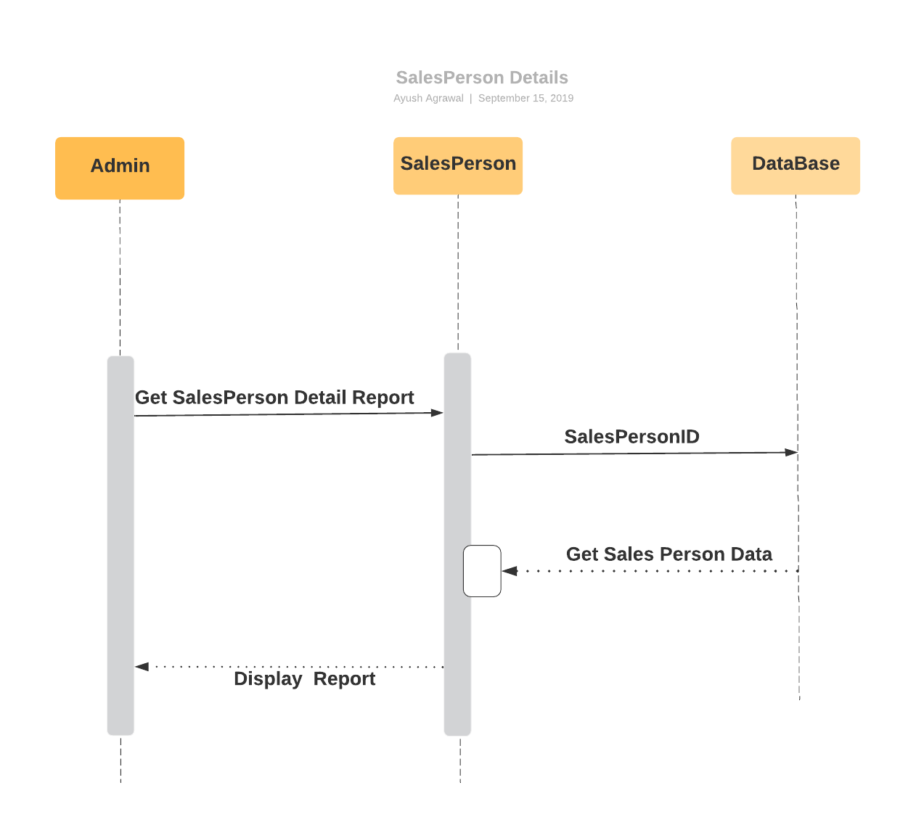
Sequence Diagram for Sales Person Details

Slide 2
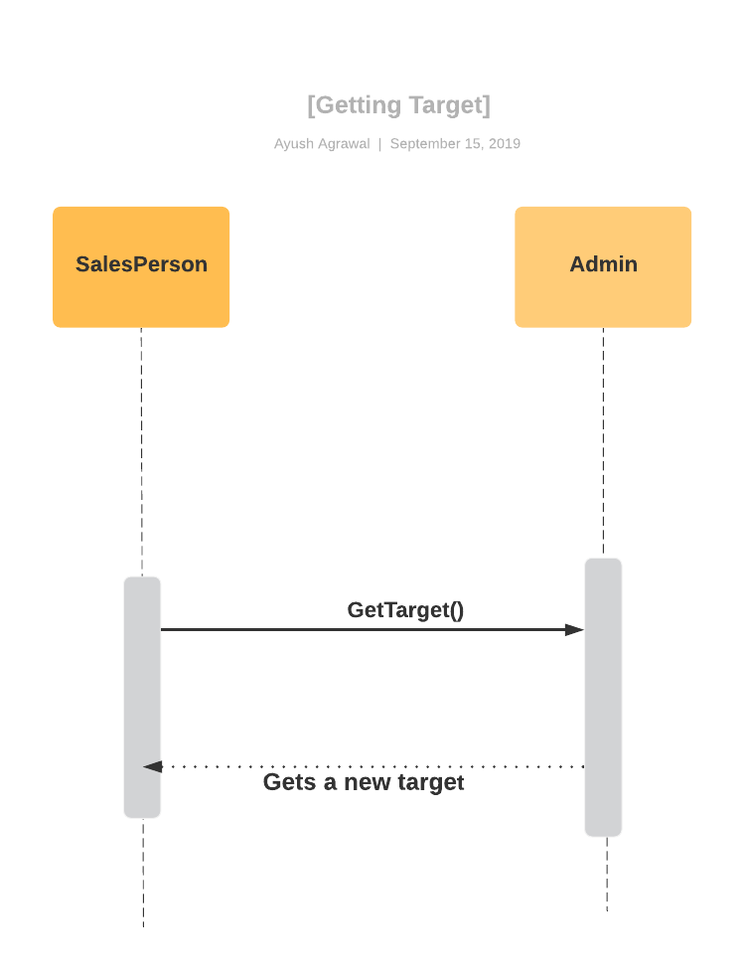
Sequence Diagram For Getting Sales Target By Sales Representatives

Slide 3
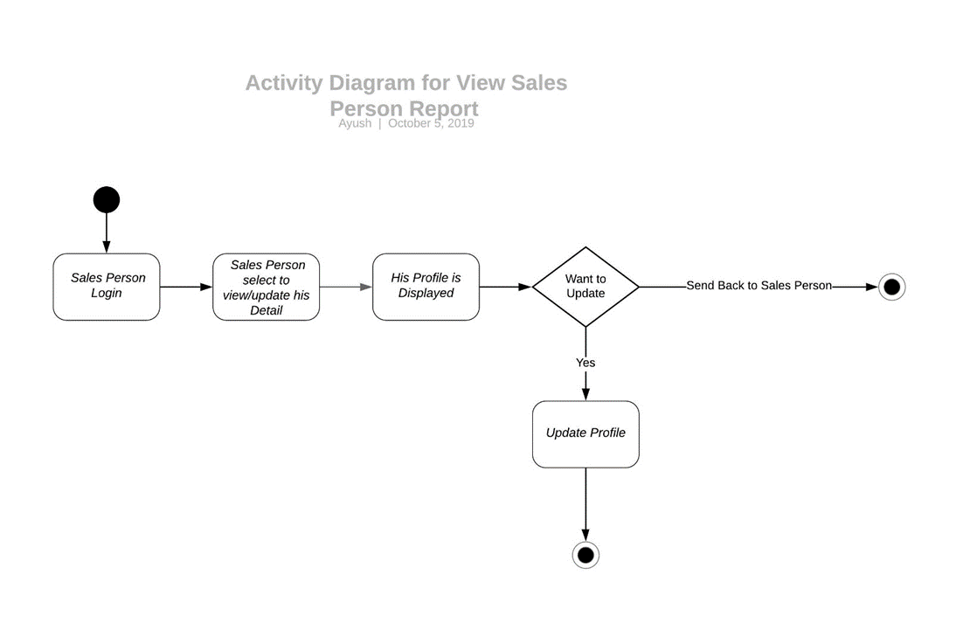
Activity Diagram For Sales Person Detail

Slide 4
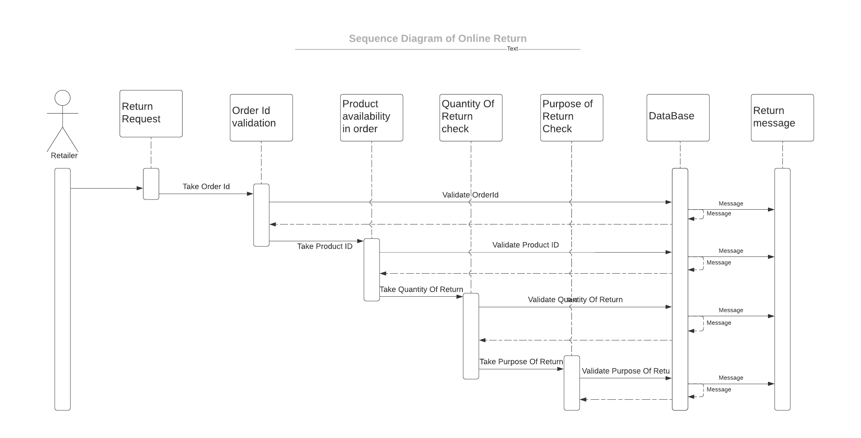
Sequence Diagram For Online Return

Slide 5
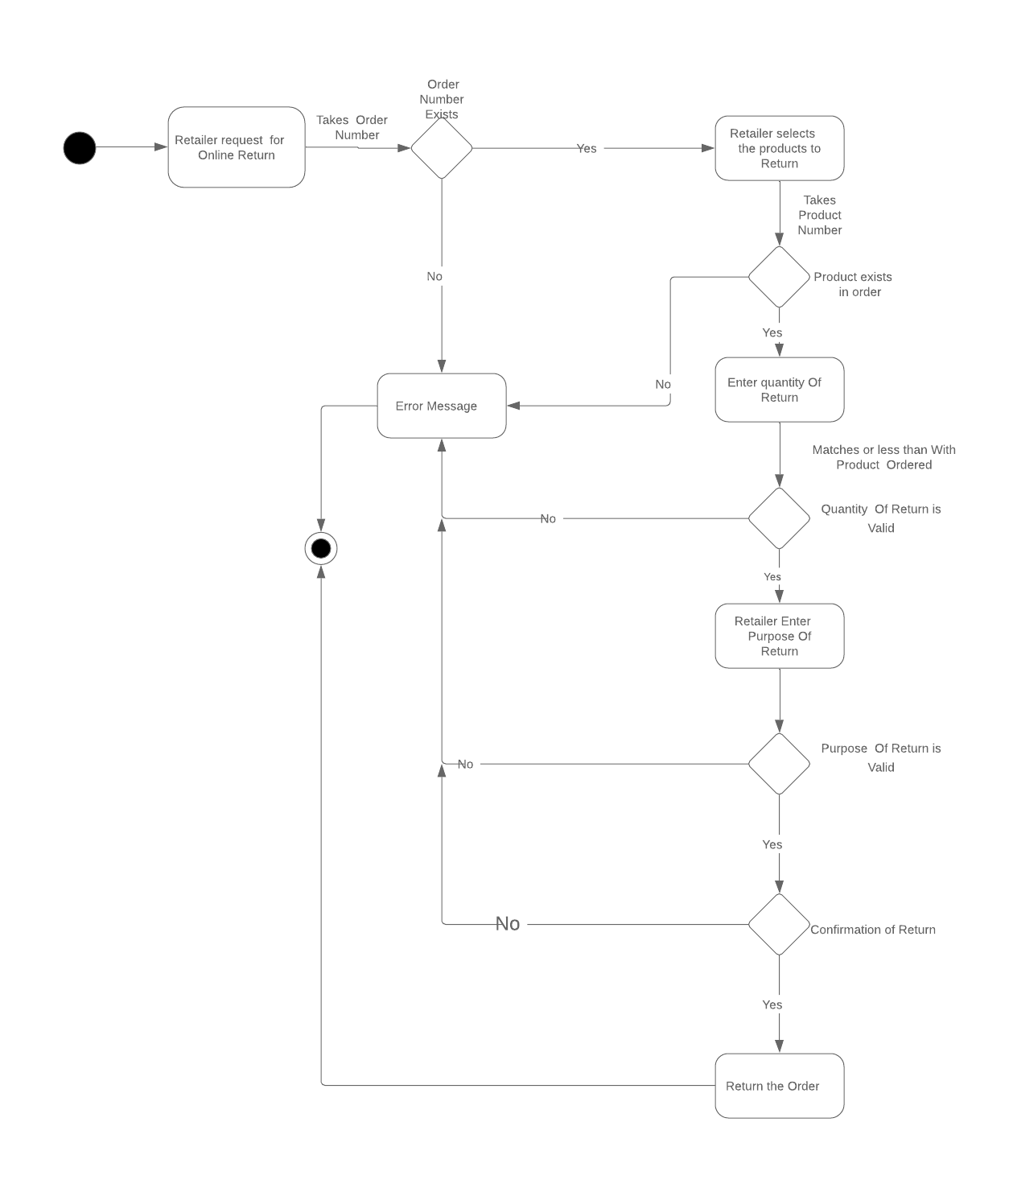
Activity Diagram for Online Return

Slide 6
Epic And User Stories
Return Online Order
Initialization of Return Order by Retailer
Validation of Product Id , Order Id and Quantity of Product
Selection of Purpose Of Return
Confirmation of Return of product by Retailer
Generate Return Id
Generating Return Reports for different purpose of return

Slide 7
Epic And User Stories
Sales Person Details
Adding, Updating , Deleting Sales Person Details
Generating Sales Person Id
Generating Sales Person Target Report for monthly ,Quarterly and Annually
Checking Status of Target met, not met or Exceeded.

Slide 8
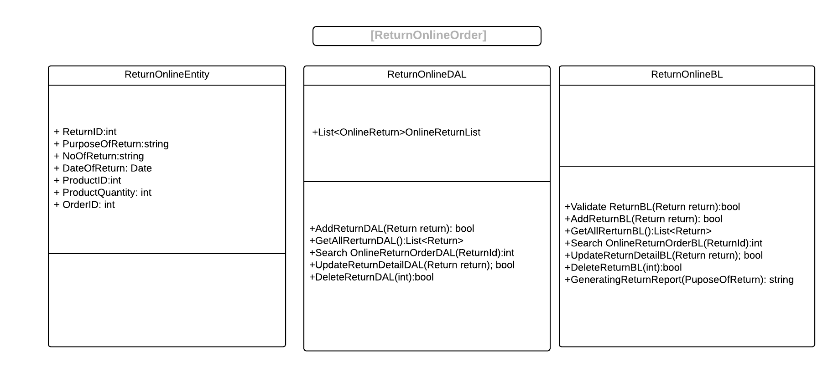
Class Diagram

Slide 9
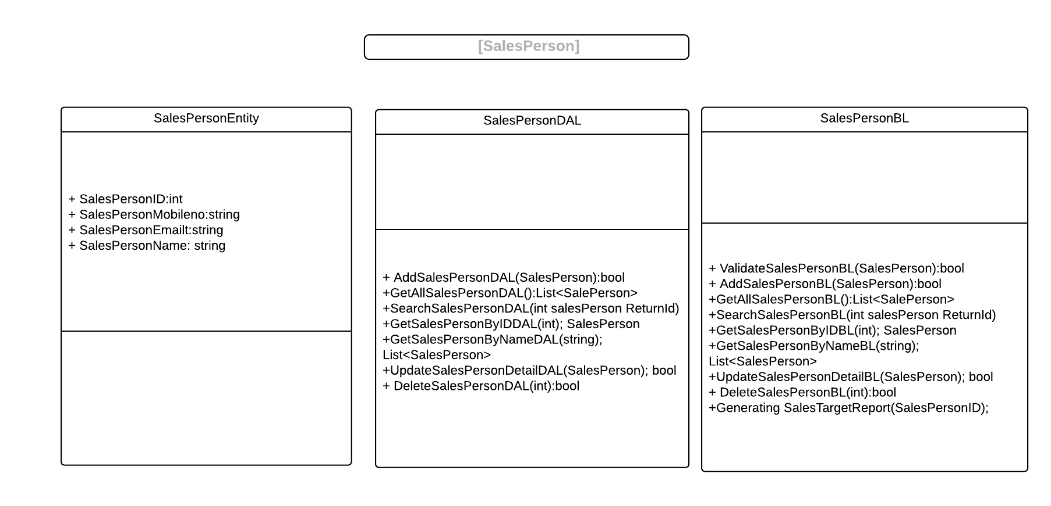
Class Diagram

